Slide 1
Quantum Dot-Coated Aircraft for Adaptive Surface Control
Revolutionizing Aerodynamics for Next-Generation Aircraft
Sakshi Biyani

Slide 2
01
Introduction

Slide 3
Problem Statement
Lockheed Martin is working on a project to develop new aerodynamic designs that improve fuel efficiency and reduce emissions. The primary challenges include optimizing the aircraft shape, integrating new aerodynamic features, and validating the performance improvements. The goal is to create an aircraft design that offers superior aerodynamic efficiency without compromising other performance aspects.

Slide 4
The Importance of Aerodynamics in Modern Aviation
Aerodynamic efficiency is crucial for reducing fuel consumption, lowering emissions, and improving overall aircraft performance.
The aviation industry is under increasing pressure to adopt more sustainable practices due to environmental regulations and rising fuel costs.
Introduction of Quantum Dot Technology: A novel approach that can potentially transform aircraft surface control, offering new possibilities for adaptive aerodynamics.

Slide 5
What Are Quantum Dots?
Definition: Quantum dots are nanoscale semiconductor particles that exhibit unique electronic and optical properties.
Properties: They can emit light, change color, and modify their conductivity based on external stimuli (e.g., light, temperature, or electric fields).
Application in Aircraft: By applying a coating of quantum dots to an aircraft’s surface, we can create an adaptive skin that adjusts in real-time to optimize aerodynamic performance, thermal management, and stealth capabilities.

Slide 6
02
Innovative Approach

Slide 7
Revolutionary Approach to Adaptive Surface Control
• Dynamic Surface Control: Quantum dot coatings allow the aircraft surface to change its texture and properties dynamically, adapting to varying flight conditions (e.g., during take-off, cruising, landing).
• Multifunctionality: These coatings can simultaneously manage aerodynamics, thermal properties, and even radar signature, making them a multifunctional solution for modern aircraft.
• Nature-Inspired Design: The adaptive properties of quantum dots are inspired by natural phenomena, such as a chameleon’s ability to change color. This biomimicry approach is applied to create a smart skin for aircraft.

Slide 8
03
Implementation

Slide 9
The key technologies involved in the quantum dot coating solution are: 1. Quantum Dot Technology: Nanoscale particles that manipulate light and electromagnetic waves for stealth and radar absorption. 2. Core-Shell Structures: Quantum dots encapsulated in stable shells (e.g., Zinc Sulfide) to enhance durability and protect from environmental degradation. 3. Graphene and Carbon Nanotubes (CNTs): Advanced nanomaterials used for thermal management, mechanical strength, and lightweight reinforcement. 4. Electromagnetic Interference (EMI) Shielding: Gold/Silver nanoparticles used to block electromagnetic interference, enhancing stealth capabilities. 5. Surface Modification Techniques: Coating methods like atomic layer deposition (ALD) ensure uniform, stable coatings on aircraft surfaces. These technologies work together to improve stealth, thermal management, mechanical strength, and aerodynamics.
Technologies Involved

Slide 10
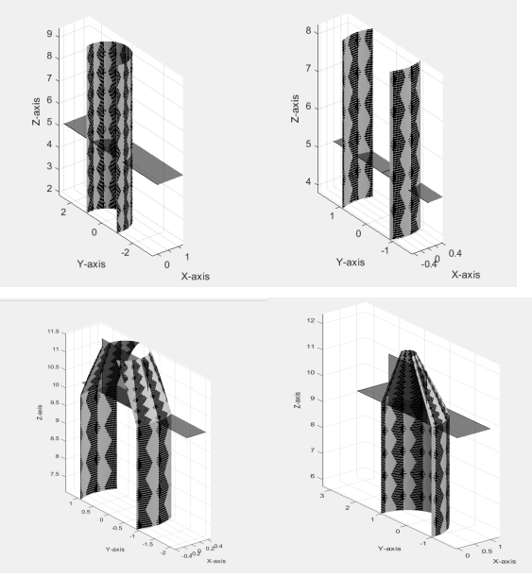
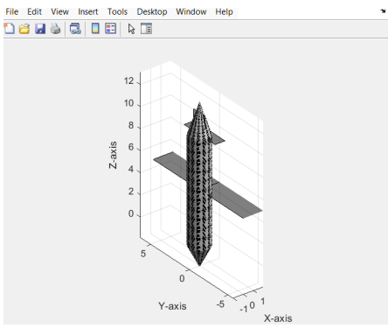
Projection at different angles

Slide 11
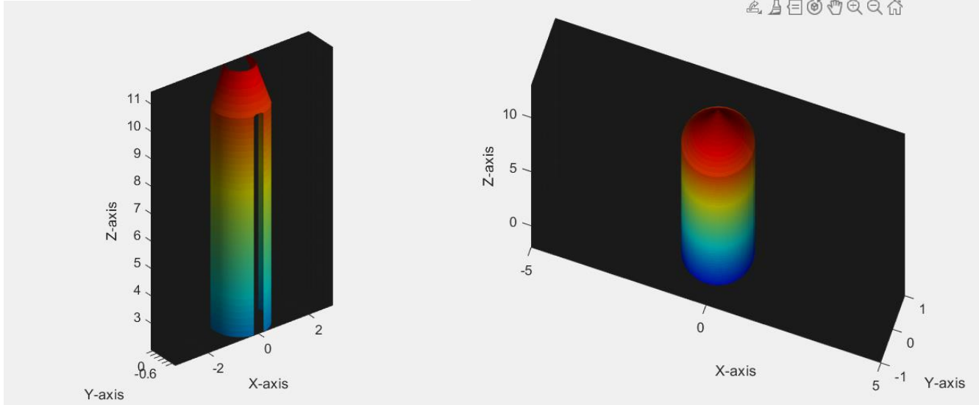
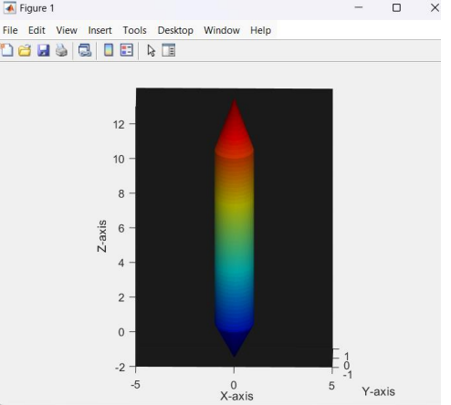
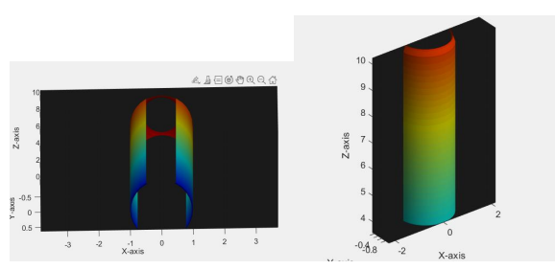
After completely applying the quantum dot coating

Slide 12
Benefits of projection at different angles
The projection of the quantum dot-coated surface at different angles shows several key aspects of the design:
1. Dynamic Surface Reflection: Due to the quantum dot coating, the surface appearance changes based on the angle of light and view. These projections highlight the iridescence and color-shifting properties of the coating, simulating how the surface reacts to environmental light, mimicking quantum dot behavior.
2. Smooth Aerodynamic Shape: From various angles, the projections reveal the airplane’s streamlined body, including the fuselage, wings, and tail. This demonstrates the design's emphasis on reducing drag and improving airflow, essential for fuel efficiency.
3. Consistent Surface Coating: The quantum dot coating is uniformly applied across the entire surface, and projections from different perspectives show the smoothness and evenness of the coating, ensuring it doesn't compromise aerodynamic performance.
4. Stealth Capabilities: Projections at different angles also show how the quantum dot coating could potentially reduce the radar cross-section, contributing to stealth features by altering how signals reflect off the surface.
These projections help visualize how the quantum dot coating interacts with light and environmental factors, illustrating its functional and aesthetic roles in improving the aircraft's performance

Slide 13

Aerodynamics of the solution
04

Slide 14
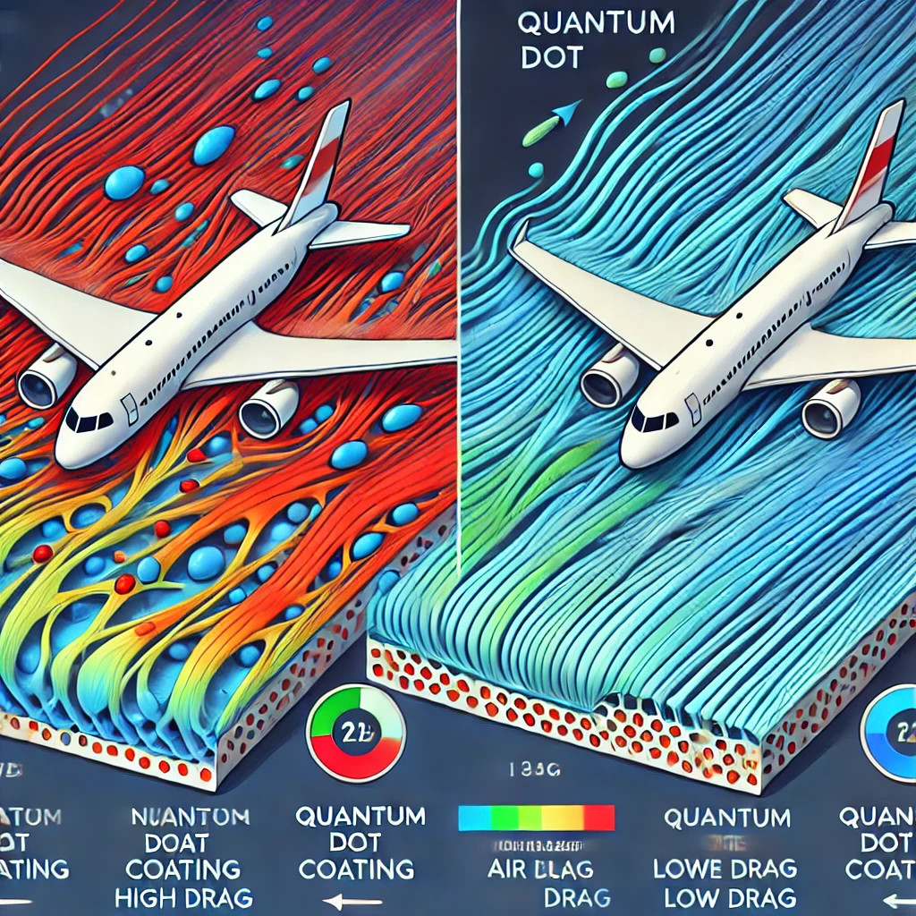

Slide 15
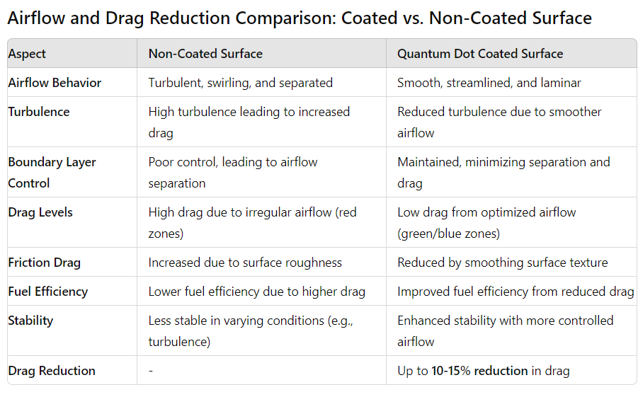

Slide 16
The quantum dot coating improves the aerodynamics of an aircraft by:
Reducing Drag: The coating smooths the surface and adapts to airflow changes, leading to smoother airflow and less turbulence, which lowers drag and boosts fuel efficiency.
Controlling the Boundary Layer: It manages the thin air layer clinging to the surface, preventing airflow separation and maintaining stability.
Active Flow Control: The coating adjusts surface properties in real-time, optimizing lift and reducing drag under different flight conditions.
Minimizing Vortex Formation: By reducing pressure differences at wingtips, it lowers vortex drag, enhancing efficiency and extending aircraft lifespan.
Improving Thermal Management: The coating dissipates heat effectively, preventing thermal expansion that can disrupt aerodynamics.
Weight Reduction: Lightweight materials like graphene reduce the aircraft’s overall weight, further enhancing fuel efficiency. This leads to better fuel economy, stability, and performance in various flight conditions.

Slide 17
Choice of materials
05

Slide 18
Best choice of materials for the solution
Indium Phosphide (InP) for optical control and non-toxicity.
Graphene Quantum Dots for thermal management and mechanical strength.
Zinc Sulfide (ZnS) core-shell structures for durability.
Gold/Silver nanoparticles for EMI shielding.
The combination of materials in the quantum dot coating provides a highly efficient and multifunctional solution for aircraft surfaces. Indium Phosphide (InP) and Gold/Silver nanoparticles enhance the aircraft's stealth capabilities by manipulating radar and electromagnetic signals, reducing the aircraft's detectability while also providing electromagnetic interference (EMI) shielding to protect onboard electronics. For thermal management, Graphene Quantum Dots and Carbon Nanotubes (CNTs) offer exceptional heat dissipation, ensuring the aircraft remains cool during high-speed flight and reducing thermal expansion that can increase drag. The use of Carbon Nanotubes and a protective Silica coating also reinforces the mechanical strength of the aircraft surface, enabling it to withstand stresses such as turbulence and rapid temperature changes. Zinc Sulfide in a core-shell structure stabilizes the quantum dots, protecting them from UV degradation and environmental wear, while the Silica coating further shields the surface from oxidation and moisture, enhancing long-term durability. Together, this combination of materials not only optimizes stealth and thermal management but also improves durability and reliability, ensuring the aircraft performs efficiently in a wide range of challenging conditions.

Slide 19
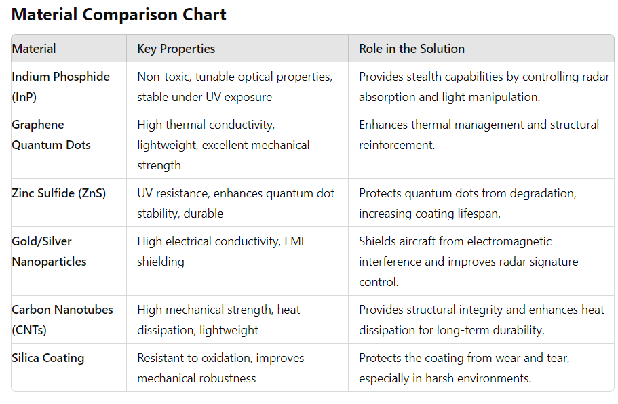

Slide 20
06
Conclusion

Slide 21
A Transformative Solution for Aviation
The proposed design successfully integrates advanced 3D modelling and quantum dot coating technology to address key challenges in improving aerodynamic efficiency, fuel consumption, and emissions reduction. The optimized shape of the airplane reduces drag, while the adaptive quantum dot coating further enhances airflow control and thermal management. This innovative approach offers potential stealth capabilities and allows for dynamic performance adaptation during flight. By combining cutting-edge materials with aerodynamic optimization, the design presents a holistic solution that meets the goals of increased efficiency and environmental sustainability without compromising overall aircraft performance.
Future Directions
Integration with Autonomous Systems: Combining adaptive surface control with fully autonomous flight systems to create highly efficient and responsive aircraft.
Sustainability: Focusing on environmentally friendly materials and energy sources to power adaptive technologies, aligning with global sustainability goals.

Slide 22
Feasibility of the Quantum Dot Coating Solution
1. Technical Feasibility: Materials like quantum dots, graphene, and carbon nanotubes are advanced and applicable in aerospace.
Proven coating techniques like atomic layer deposition can uniformly apply these materials to aircraft surfaces. Quantum dots offer potential for real-time aerodynamic and thermal optimization, though some aspects still require further research.
2. Cost Feasibility: High initial production costs due to advanced nanomaterials. Long-term savings from reduced drag and improved fuel efficiency could justify the investment over time.
In summary, while initial costs may be high, the technical viability and long-term operational benefits make the solution feasible for future implementation.

Slide 23
Progress from round 1 to round 4
Round 1: Assess foundational knowledge related to aviation.
Round 2: Conduct in-depth research analysis and develop a case study on the chosen problem statement.
Round 3: Developed and submit innovative ideas based on research findings.
Round 4: Finalize and present a comprehensive design solution, including a technical presentation.
The journey from Round 1 to Round 4 involved a progression from individual assessment to collaborative research, followed by innovative idea development, and culminating in the design and presentation of a comprehensive technical solution. Each round built upon the previous one, fostering growth and refinement of ideas, and enhancing my understanding of the problem and potential solutions.

Slide 24
THANKYOU

